Slide 1

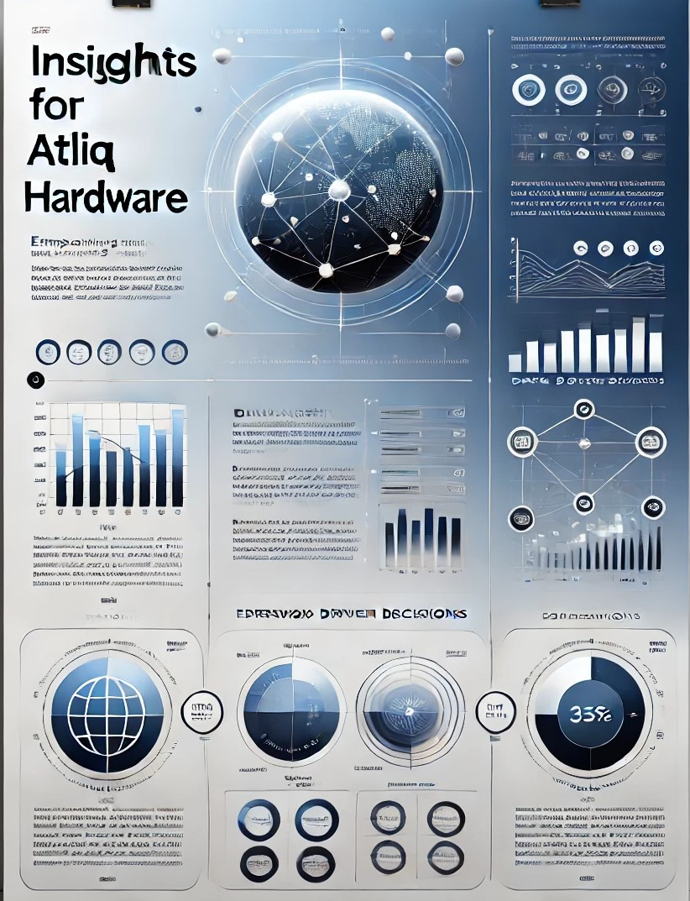


INSIGHTS FOR ATLIQ HARDWARE
BY TALLURI KIRAN DATTA

Slide 2

PROBLEM STATEMENT
Atliq Hardwares (imaginary company) is one of the leading computer hardware producers in India and well expanded in other countries too. Despite data being available the management is unable to uncover insights to make quick and smart decisions. They want to expand their data analytics team by adding several junior data analysts.
Tony Sharma, the Data Analytics Director, wants to hire a professional skilled in both technical and soft skills. So, Tony crafted a challenging SQL-based evaluation designed to test not just technical expertise but also the ability to derive actionable insights from complex datasets. This involves analyzing a simulated database, writing SQL queries to address ad-hoc business questions, and generating meaningful insights. It is also expected to create impactful visualizations to present these insights to support strategic decision- making. Tony's ideal hire would possess a strong blend of technical acumen (SQL expertise, data visualization, and analytics) and interpersonal prowess (clear communication and compelling presentation skills)

Slide 3


AD HOC REQUEST 1:
Provide the list of markets in which customer "Atliq Exclusive" operates its business in the APAC region.
QUERY
OUTPUT

Slide 4
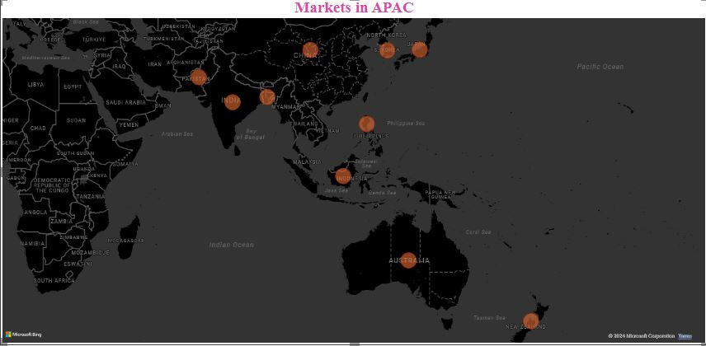
Visual 1:
INSIGHT
Atliq Hardware's strategic focus on the Asia Pacific region positions them to capitalize on a diverse and dynamic market landscape. By targeting both emerging economies like the Philippines and Indonesia, as well as mature markets like Japan and India, Atliq gains exposure to a vast consumer base with varying levels of purchasing power and technological sophistication.
By successfully navigating this complex and competitive market, Atliq Hardware demonstrates its strong market understanding, adaptability and commitment to delivering value to its customers

Slide 5
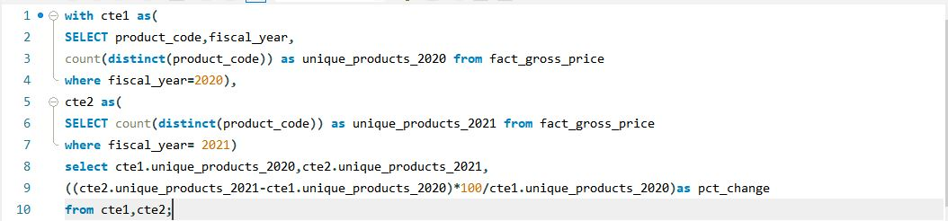

AD HOC REQUEST 2:
What is the percentage of unique product increase in 2021 vs. 2020? The final output contains these fields, unique_products_2020, unique_products_2021, percentage_chg
QUERY
OUTPUT

Slide 6
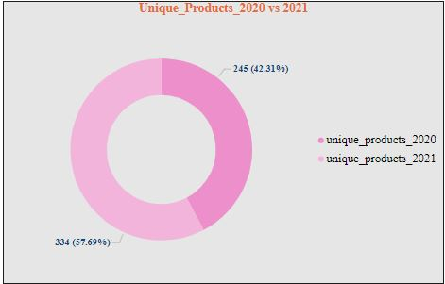
Visual 2:
INSIGHT
The 36.33% increase in unique products from 2020 to 2021 suggests that the company is actively responding to increased consumer demand and emerging market trends.
This proactive approach to product development demonstrates the company's agility and its ability to capitalize on new opportunities.

Slide 7
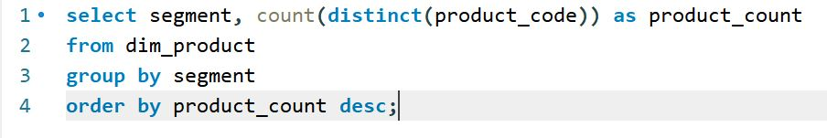
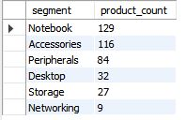
AD HOC REQUEST 3:
Provide a report with all the unique product counts for each segment and sort them in descending order of product counts. The final output contains 2 fields segment, product_count
QUERY
OUTPUT

Slide 8
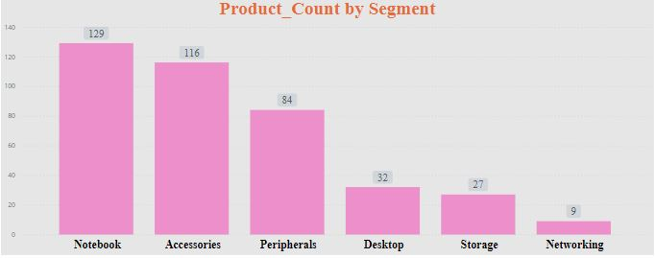
Visual 3:
INSIGHT
Notebooks, Accessories, and Peripherals, comprising 32%, 29.2%, and 21% of the product range, respectively, dominate the product mix. This could be attributed to either high market demand or deliberate strategic emphasis.
Conversely, the lower product counts in Storage and Networking might suggest a more specialized approach to cater to specific customer requirements.
To make decisions better, it is crucial to analyze the profit margins and revenue generated by each product segment.

Slide 9
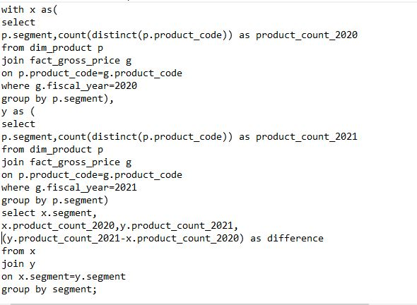
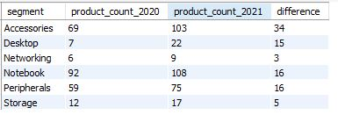
AD HOC REQUEST 4:
Follow-up: Which segment had the most increase in unique products in 2021 vs 2020? The final output contains these fields segment, product_count_2020, product_count_2021, difference.
QUERY
OUTPUT

Slide 10
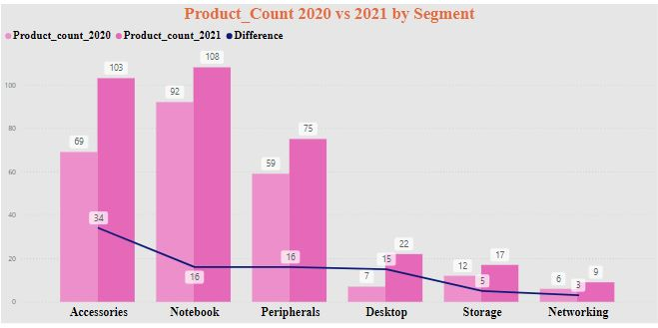
Visual 4:
INSIGHT
The Accessories segment experienced a significant rise, from 69 to 108 products. Notebooks and Peripherals also saw moderate increases. In contrast, Storage and Networking segments remained relatively stable, suggesting steady demand.
The increase in certain segments, coupled with the stability of others, might be attributed to market saturation, technological advancements, or the company's strategic focus on specific products.

Slide 11
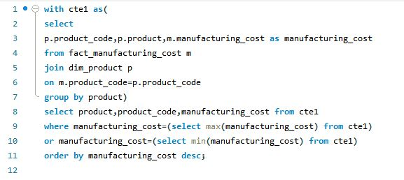

AD HOC REQUEST 5:
Get the products that have the highest and lowest manufacturing costs. The final output should contain these fields product_code, product, manufacturing_cost.
QUERY
OUTPUT

Slide 12
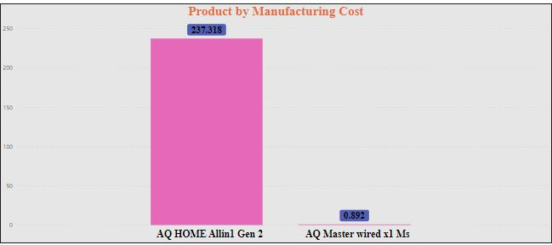
Visual 5:
INSIGHT
The "AQ Home Allin1 Gen 2" incurs significantly higher manufacturing costs than the "AQ Master wired x1 Ms." This difference can be explained by variations in production processes and material costs.
Additionally, these two products can be catering to distinct market niche, with the "AQ Home Allin1 Gen 2" potentially targeting a premium market.

Slide 13
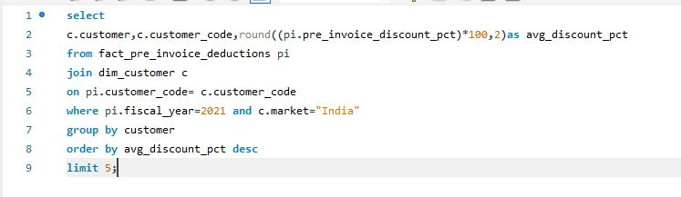
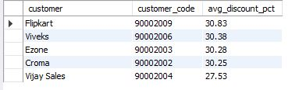
AD HOC REQUEST 6:
Generate a report which contains the top 5 customers who received an average high pre_invoice_discount_pct for the fiscal year 2021 and in the Indian market. The final output contains these fields customer_code, customer, average_discount_percentage.
QUERY
OUTPUT

Slide 14
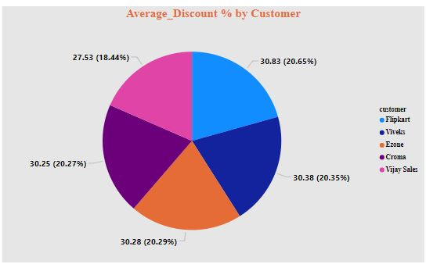
Visual 6:
INSIGHT
Flipkart gets the highest average discount of 30.83% while Vijay Sales trailing below at 27.53%.
The higher average discount rates offered to Flipkart and Viveks indicates a larger consumer base for Atliq, necessitating higher discounts.
All other customers have almost similar discount rates. Similar discounts across different customers suggest a competitive pricing environment.

Slide 15
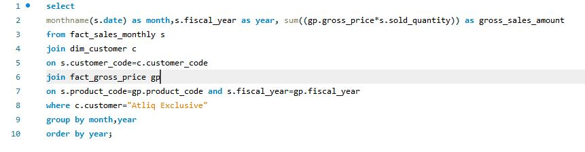
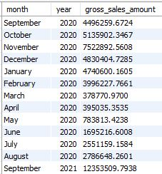
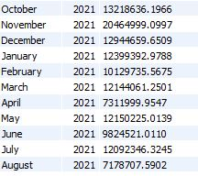
AD HOC REQUEST 7:
Get the complete report of the Gross sales amount for the customer “Atliq Exclusive” for each month . This analysis helps to get an idea of low and high-performing months and take strategic decisions. The final report contains these columns: Month, Year, Gross sales Amount.
QUERY
OUTPUT

Slide 16
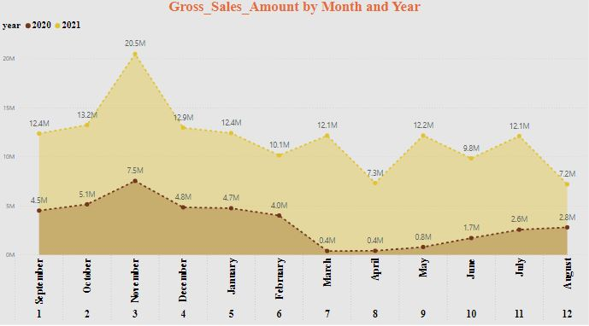
Visual 7:
INSIGHT
The gross sales both in 2020 and 21 started high in November and gradually declined through the year, with a significant drop in February and March.
There seems to be a seasonal pattern, with sales generally higher in the second half of the year. This can be attributed to factors like festival/holiday shopping, end-of-year purchases.
This can help the company optimize inventory and supply chain management to better respond to fluctuating demand.

Slide 17
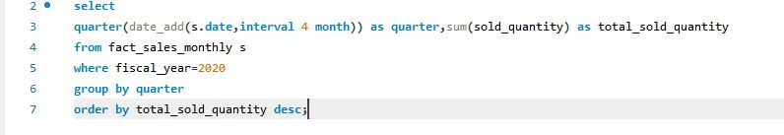

AD HOC REQUEST 8:
In which quarter of 2020, got the maximum total_sold_quantity. The final output contains these fields sorted by the total_sold_quantity, Quarter, total_sold_quantity
QUERY
OUTPUT

Slide 18
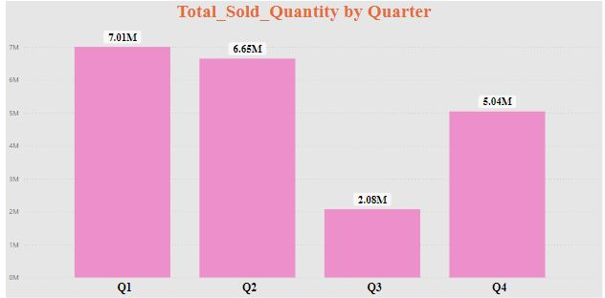
Visual 8:
INSIGHT
Q1 (Atiq's financial year starts in September) saw the highest sales with 7.01 million units sold, while Q3 was the weakest quarter.
This indicates a strong seasonal influence on sales.
To effectively manage inventory and supply chain, the company should adapt to these changing demand patterns.

Slide 19
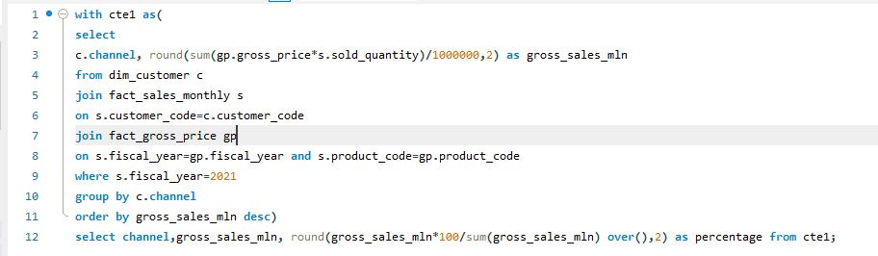

AD HOC REQUEST 9:
Which channel helped to bring more gross sales in the fiscal year 2021 and the percentage of contribution? The final output contains these fields channel, gross_sales_mln, percentage
QUERY
OUTPUT

Slide 20
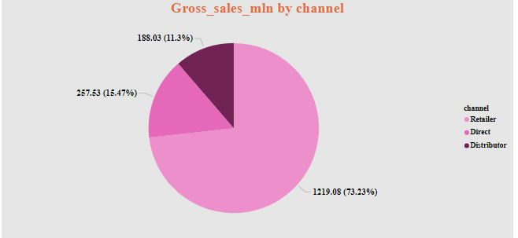
Visual 9:
INSIGHT
The significant dominance of the distributor channel (73.23%) highlights the need for a balanced distribution strategy.
While distributors are crucial for market reach, the company should explore ways to increase direct sales to improve profit margins and customer relationships.
This could involve strengthening e-commerce, building a direct sales force, or partnering with strategic retailers.

Slide 21
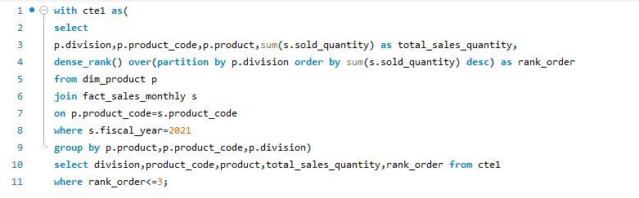
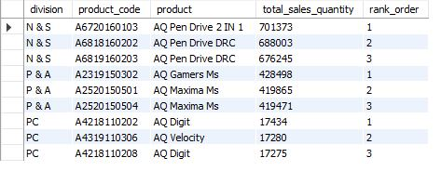
AD HOC REQUEST 10:
Get the Top 3 products in each division that have a high total_sold_quantity in the fiscal_year 2021. The final output contains these fields division, product_code, product total_sold_quantity, rank_order.
QUERY
OUTPUT

Slide 22
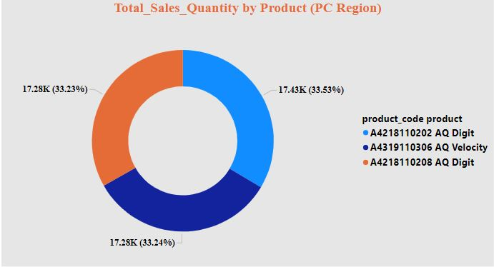
Visual 10:
INSIGHT
The chart represents sales data for the PC Region. The sales quantity is almost evenly distributed among the three products.
The near-equal distribution suggests that all three products are relatively popular in the PC Region.
The company might consider focusing on promoting product A4319110306 (AQ Velocity) slightly more to capitalize on its slightly higher demand.

Slide 23
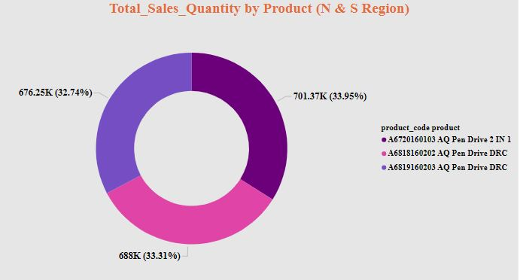
INSIGHT
The top 3 products are pen-drives of different variants. This indicates strong consumer base for pen drives.
The company must focus on effectively managing the inventory to meet the demand expectations.
.

Slide 24
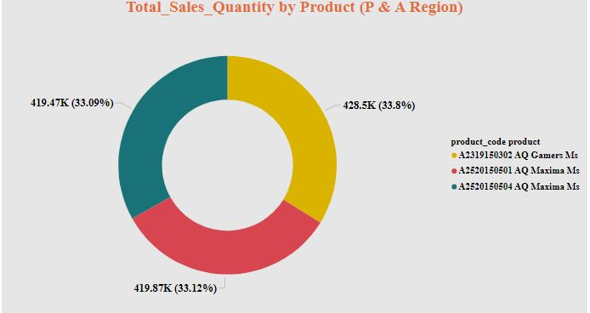
INSIGHT
The sales quantity is almost evenly distributed among the three mouse models. Each model accounts for approximately one-third of the total sales quantity.
Product Similarity: The near-equal distribution suggests that all three mouse models are relatively similar in terms of features, pricing, and customer appeal in the P & A region.

Slide 25
THANK YOU

